Slide 1
CUSTOMER PRODUCTS’ PRICES AND PERFORMANCE PREDICTION
Predicting How products will fare

Slide 2

Overview
Price and demand are generally believed to move in opposite directions. Changes in price usually cause a movement along the demand curve, but not a complete shift.
Understanding how a potential price change could affect product sales and vice-versa is very important in developing good strategies to improve sales and increase profit. In this project, I built some machine learning models that will help predict future prices and quantity sales of products based on price changes, using patterns of known changes in prices and quantity demanded.

Slide 3


Problem Statement At what prices will consumer products be sold and what is the likely performance of such products after anticipated price changes?

Slide 4

Audience This project was carried out to help manufacturers and management of retail stores track, analyze, assess and determine stock prices of products, as well as make likely predictions of products’ sales based on anticipated price changes.

Slide 5
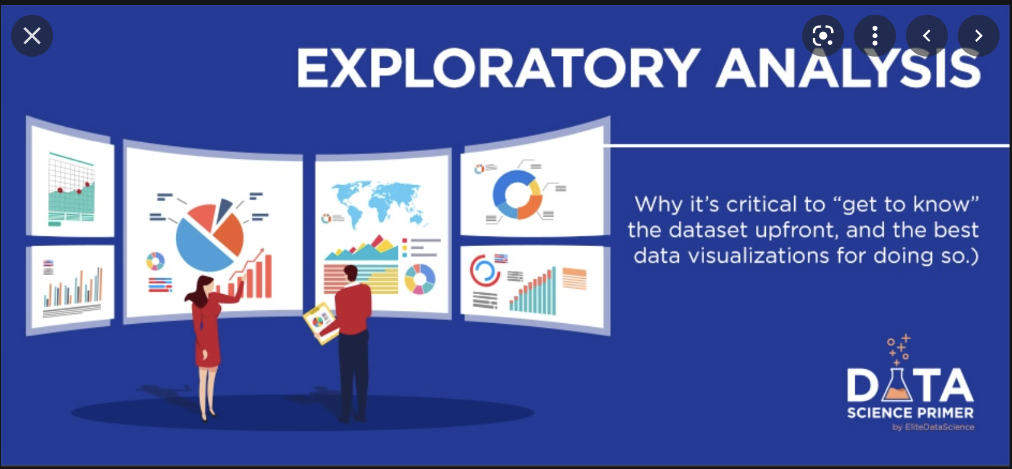
EXPLORATORY DATA ANALYSIS

Slide 6
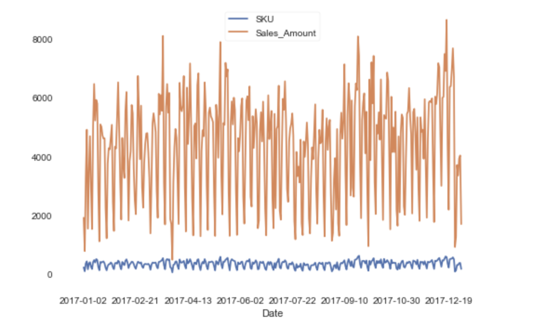
There is no particular pattern in the number of unique products sold or their prices.

Slide 7
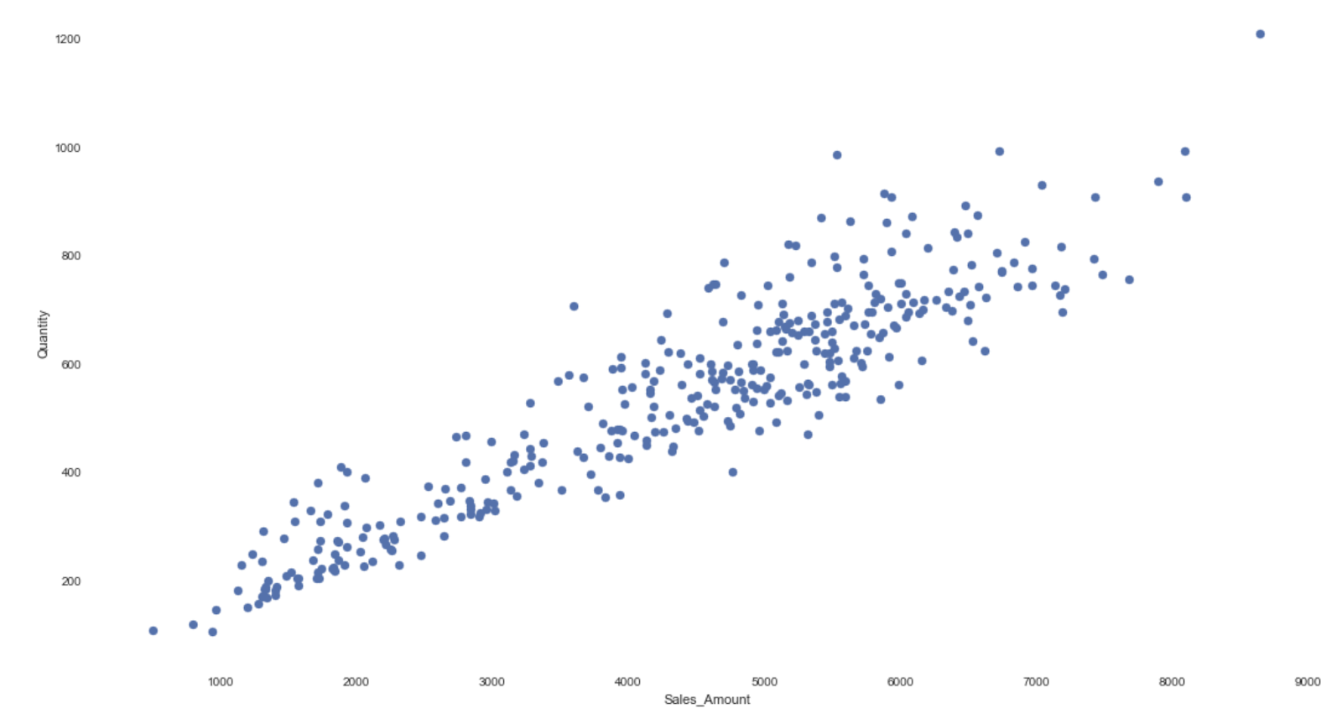
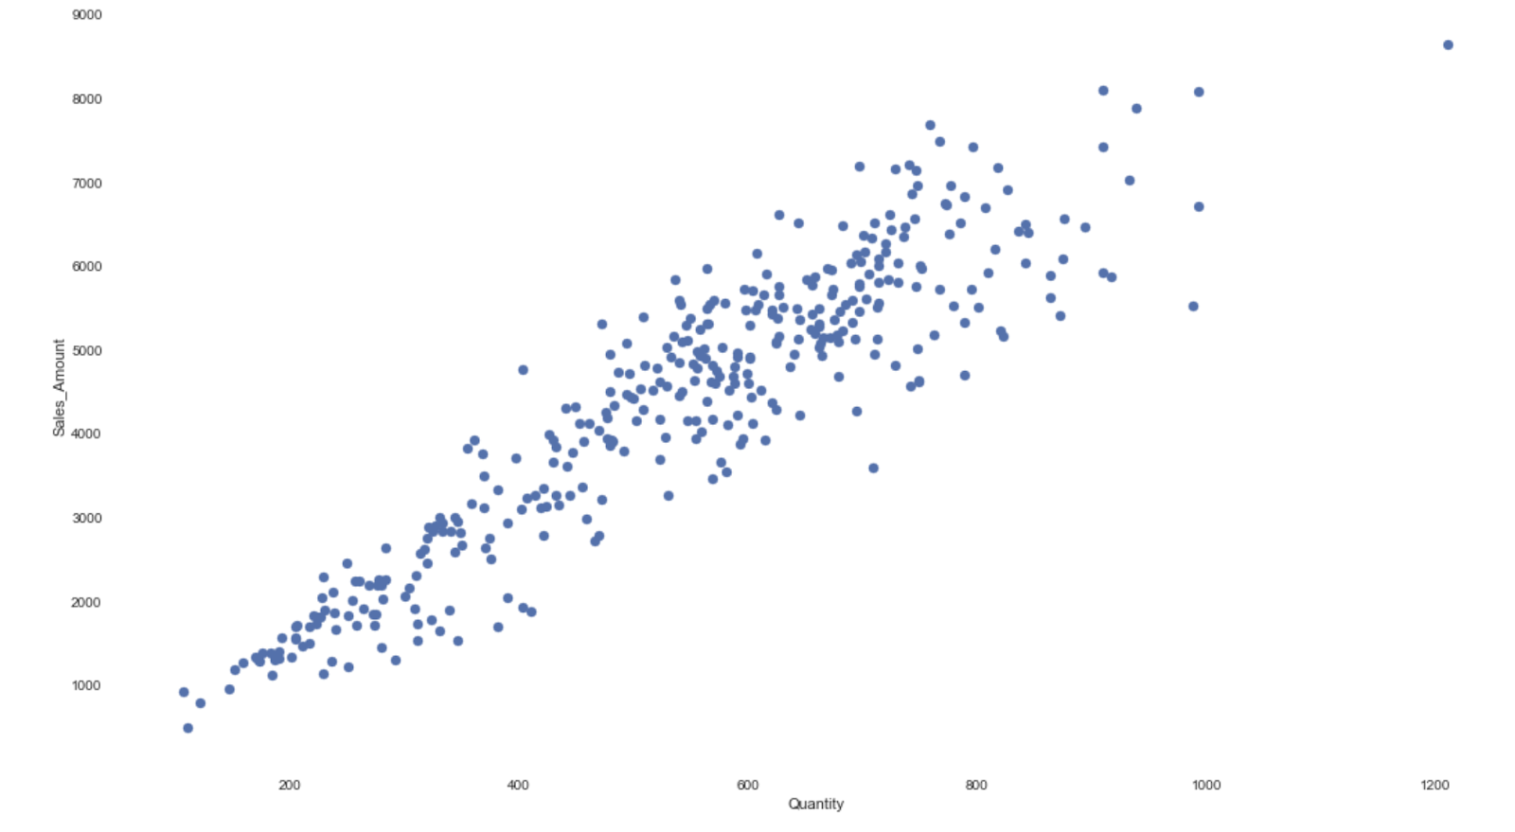
Most times, there is a positive correlation between price and quantities of products sold.

Slide 8
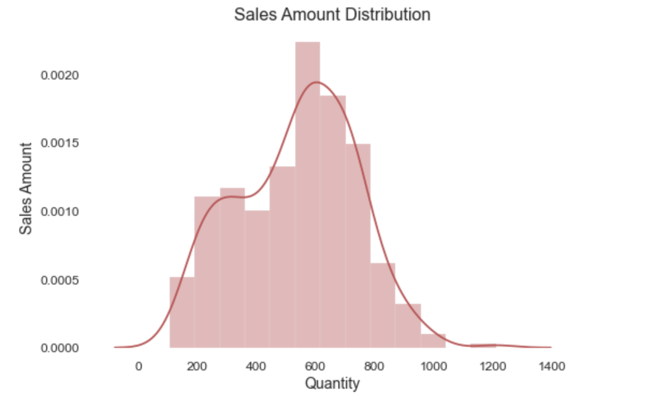
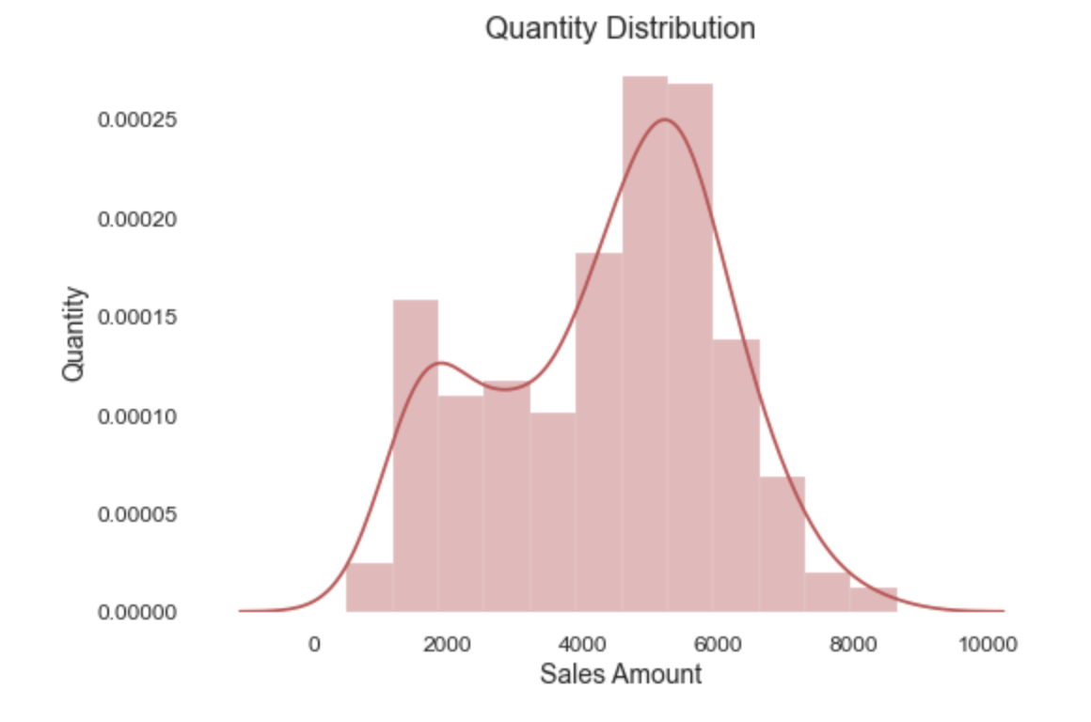
There are irregular patterns in price and quantities sold.

Slide 9

MODELING

Slide 10

After deployment, every model had a variance and R-Squared scores of either approximately 0.92 (92%) or 0.94 (94%) for predicting sales price of products, and Variance and R-Squared scores of 0.87 (87%) for predicting quantity of products that will be sold based on product prices.

Slide 11
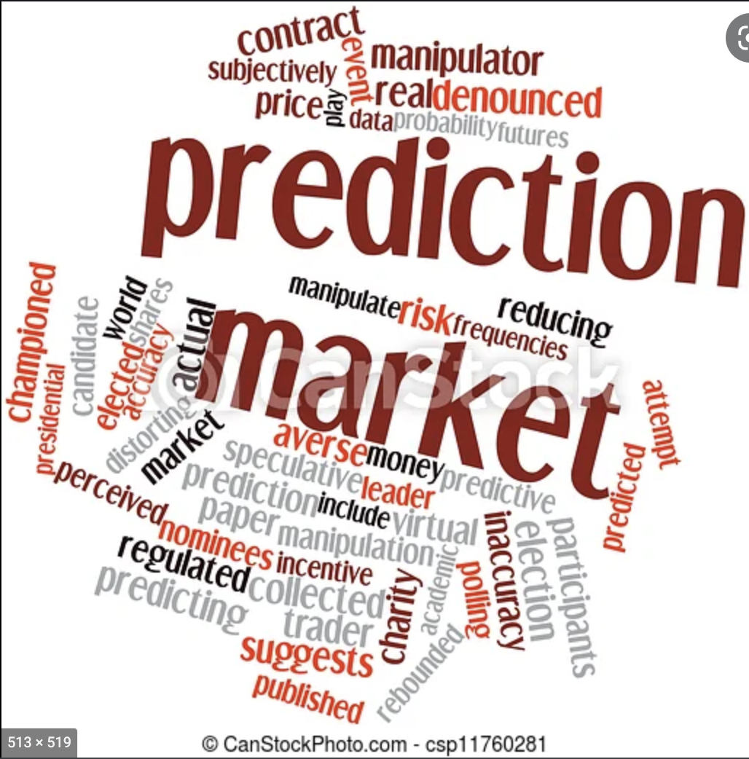
Price Prediction

Slide 12
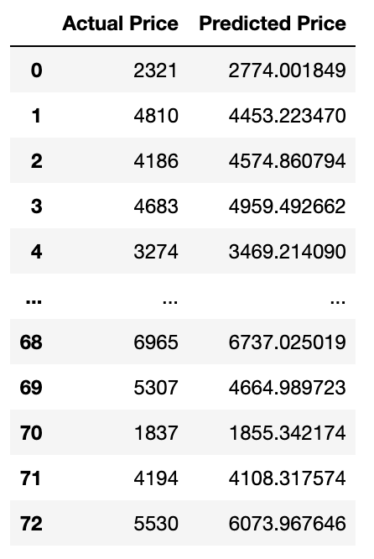
Best Prediction: Bayesian Model Prediction( R- Square and Variance Scores of ~ 93.71%) .

Slide 13
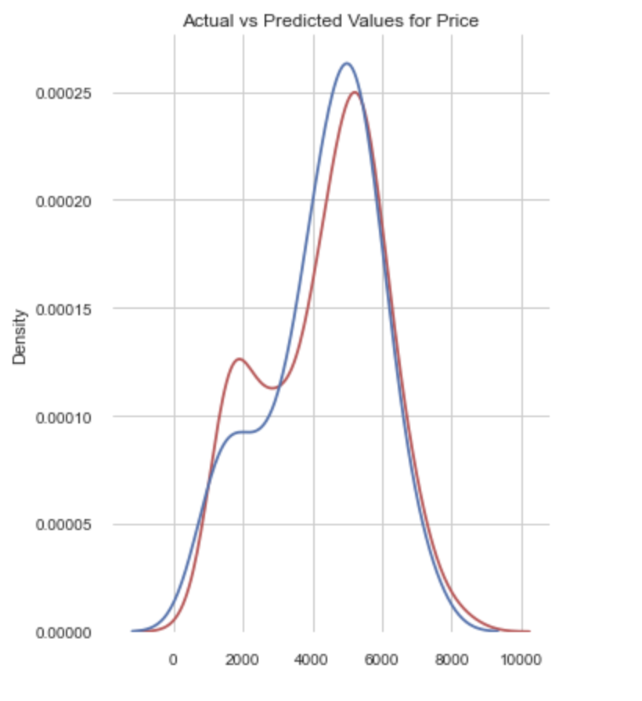
Bayesian Prediction Visualization (NB: Actual price is in red and the predicted is blue)

Slide 14
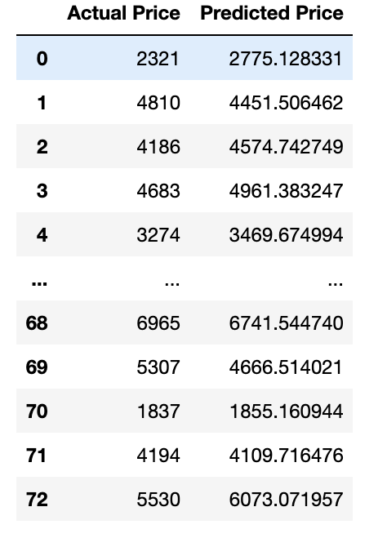
Second Best Prediction: ElasticNet (Variance = 93.70%, R-Squared = 93.70)

Slide 15
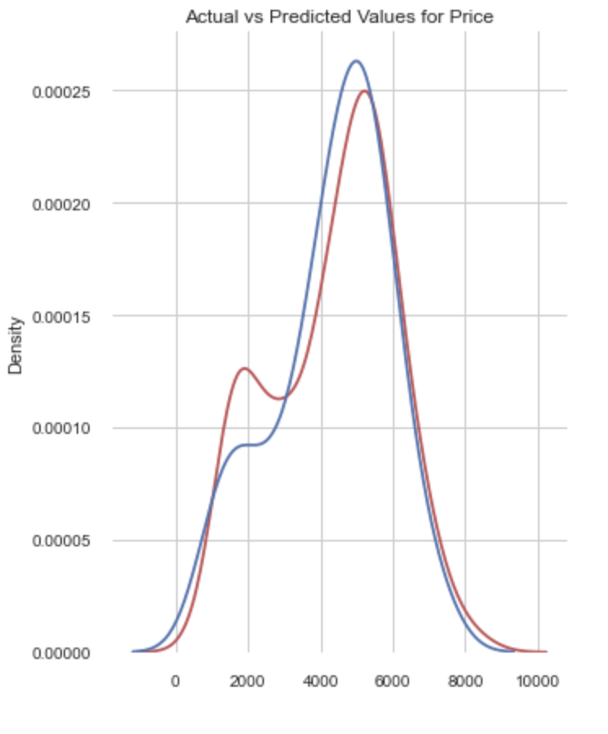
NB: Actual price is in red and the predicted is blue.

Slide 16

Quantity Prediction

Slide 17
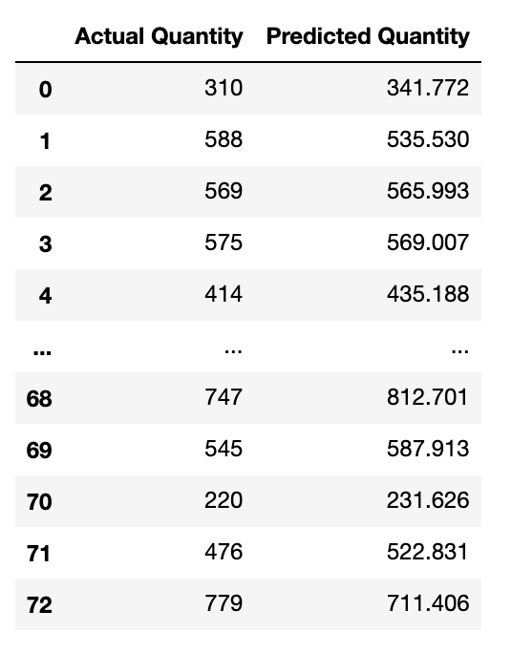
Best Prediction: Random Forest Model (Variance = ~86.96%, R-Squared = ~86.96)

Slide 18
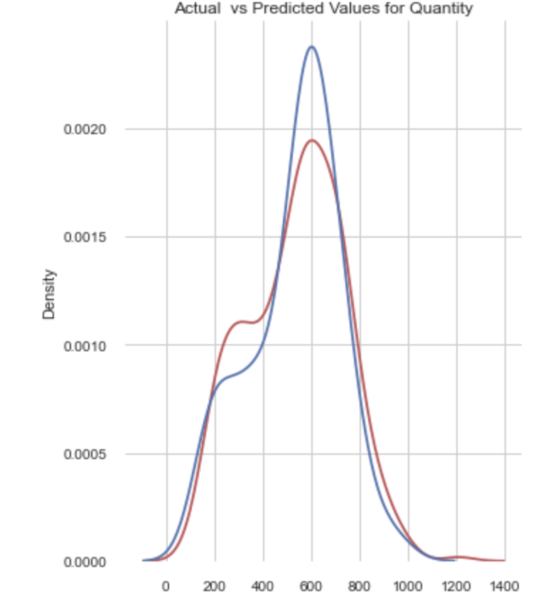
Random Forest Prediction Visualization (NB: Actual price is in red and the predicted is blue)

Slide 19
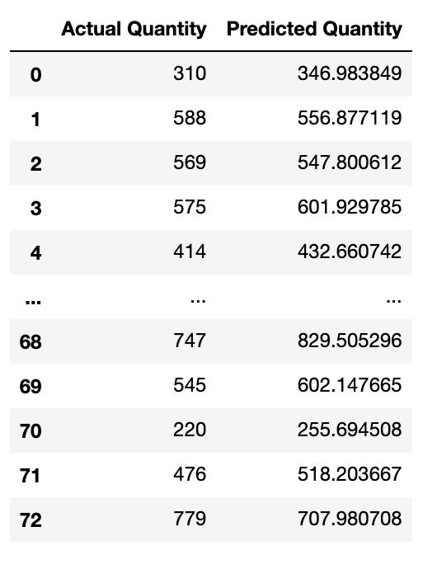
Second Best Prediction: Bayesian (Variance = 86.66%, R-Squared = 86.66%)

Slide 20
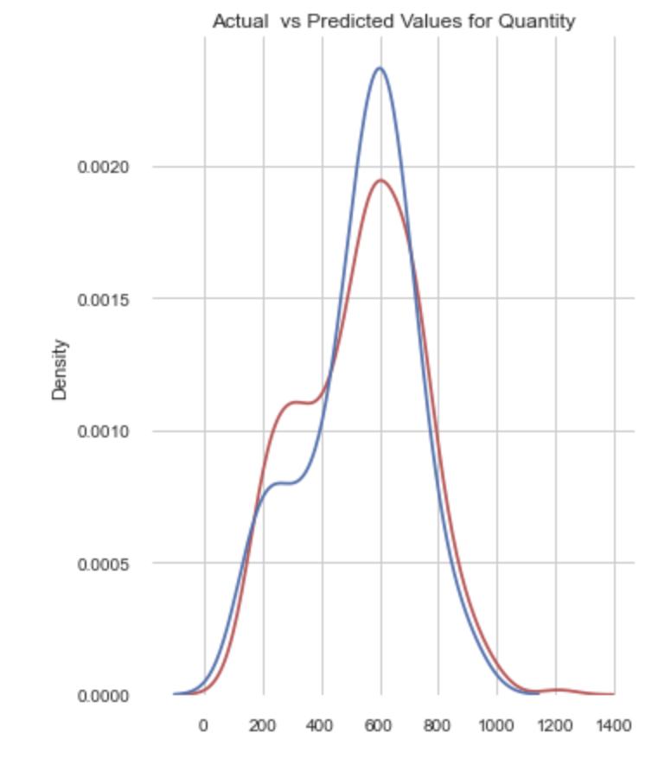
NB: Actual quantity is in red and the predicted is blue.

Slide 21
Conclusion
After evaluation, it can be concluded that the Bayesian or ElasticNet regression models should be used for price prediction and the Random Forest or Bayesian models should be used to predict sales quantity in this case.
These models have the tendency to make near-perfect predictions, which would help decision makers make the best possible business decisions for maximum profitability.

Slide 22
Future Improvements
Other powerful models like the Neural Networks, Time Series, along with models like the Boosted decision tree model, the Poisson regression model, etc, should be used to make these predictions and their performances compared to the ones of the models used in this project. Also, I believe limited data information restricted the flow of this project and other things that could have been predicted. Actual products and category names should be provided in the data to help in predicting how change in prices of substitute products can affect sales of certain goods. This will also help to adequately predict customers’ purchase patterns.

